Slide 1
CAPSTONE PROJECT
IPL CRICKET PREDICTION
Presented By:
MUTHURAM M
CARE COLLEGE OF ENGINEERING
BE CIVIL ENGINEERING

Slide 2
OUTLINE
Problem Statement
Proposed System/Solution
System Development Approach
Algorithm & Deployment
Result
Conclusion
Future Scope
References

Slide 3


PROBLEM STATEMENT
To Analyze the IPL Cricket Match and Predict the Winning Team from 2008 to 2022

Slide 4
PROPOSED SOLUTION
Data Collection
Data Preprocessing
Feature Selection
Model Selection
Model Training
Model Evaluation
Prediction

Slide 5
SYSTEM APPROACH
Modules
Python: Core programming language for development.
Pandas: Data manipulation and analysis.
numpy : working with arrays
Scikit-learn: Machine learning algorithms for prediction.
Matplotlib / Seaborn: Data visualization for insights.
Jupyter Notebook: Interactive development and presentation.
Database collected
Epson cricket: Datas were collected
Software
Google colab

Slide 6
ALGORITHM & DEPLOYMENT
We load historical IPL data and select relevant features such as win percentage, batting average, bowling average, etc.
We split the data into training and testing sets.
We train a Random Forest classifier on the training data.
We evaluate the model's accuracy on the testing set.
We predict the final teams for the upcoming IPL based on the latest statistics using the trained model.

Slide 7
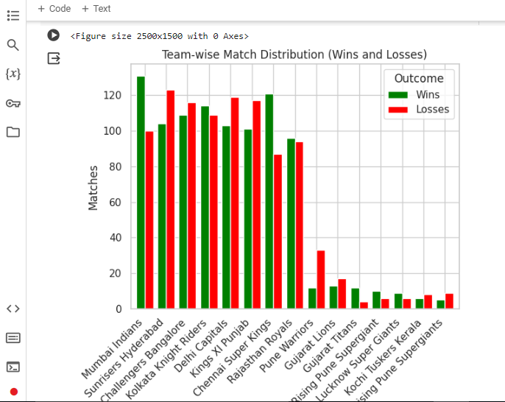
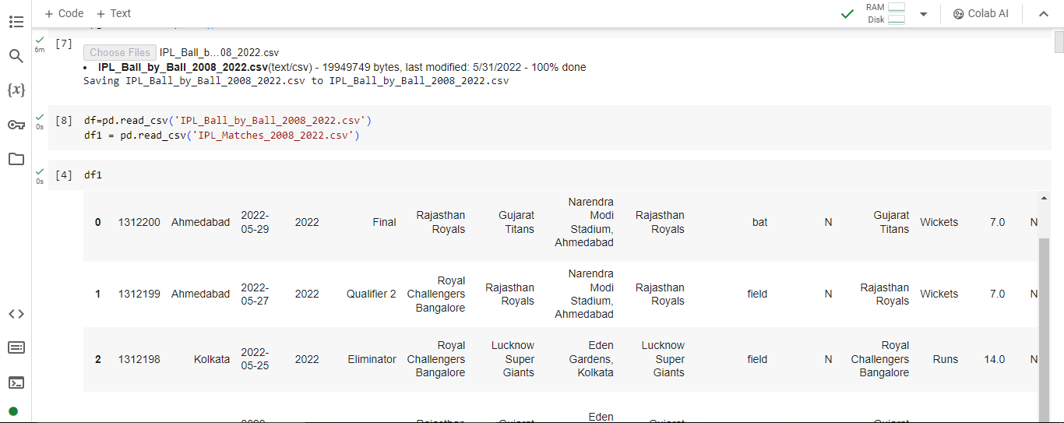
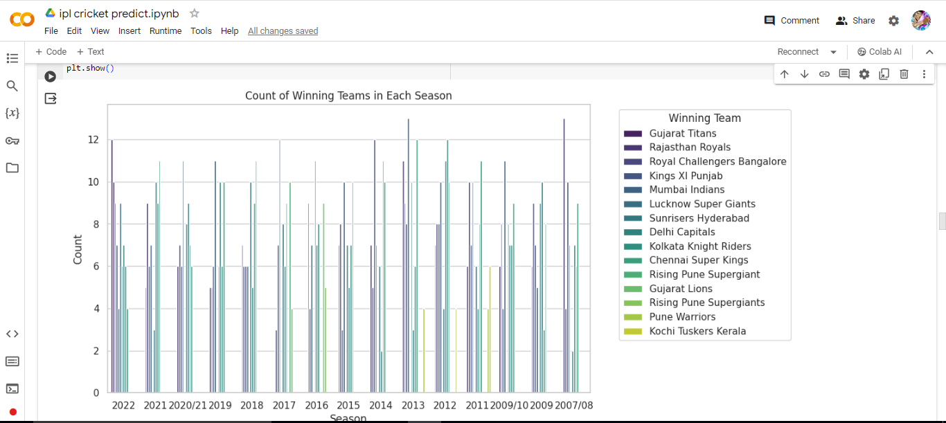
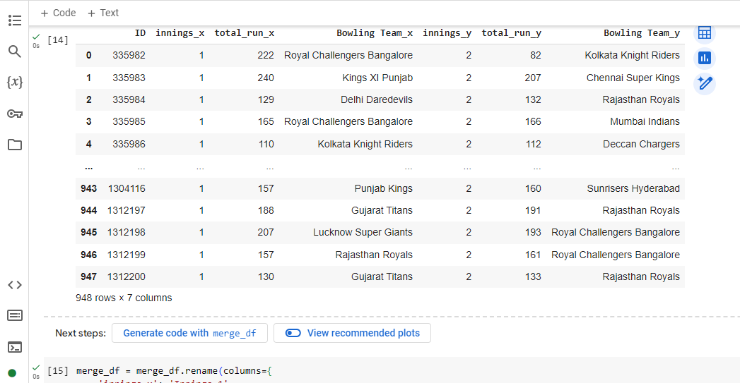
RESULT

Slide 8
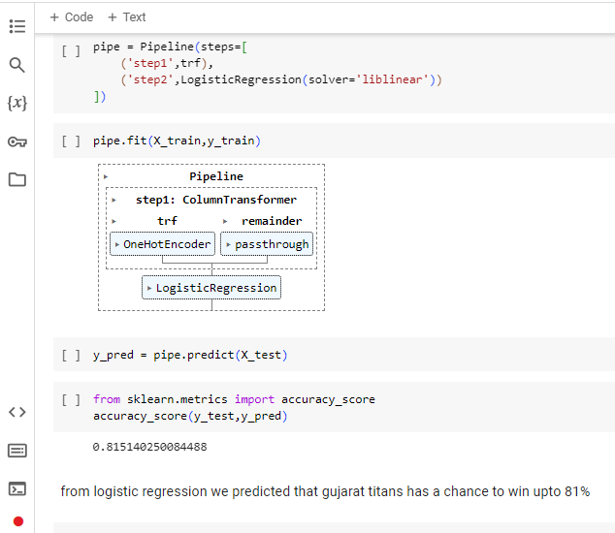
CONCLUSION
Here we have tested to predict for 2022 final list
Our upcoming motive to predict the finalist team in 2024
we are collecting to get datas IPL venue for 2024

Slide 9
FUTURE SCOPE
we have to predict for 2025 after the matches which is not scheduled by their venue and match tables
Data Analytics and Machine Learning
Sentiment Analysis and Social Media
Injury Prediction and Player Performance Analysis
Weather Forecasting Integration
Real-time Data Integration
Crowdsourced Predictions
Interdisciplinary Approaches

Slide 10
REFERENCES
Getting dataset from epson cricket dataset website python data science
It is referenced in kaggle website

Slide 11
THANK YOU

